Slide 1
Polarization
P47 – Optics: Unit 5

Slide 2
Unit 5
Course Outline
Unit 1: Electromagnetic Waves
Unit 2: Interaction with Matter
Unit 3: Geometric Optics
Unit 4: Superposition of Waves
Unit 5: Polarization
Unit 6: Interference
Unit 7: Diffraction
Unit 8: Fourier Optics
Unit 9: Modern Optics

Slide 3
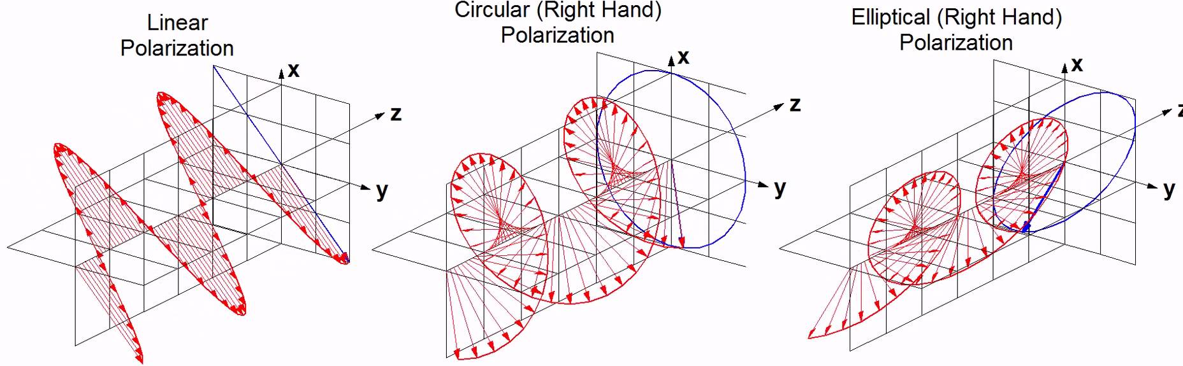
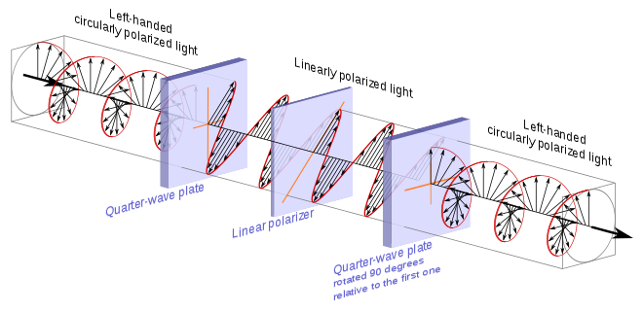
Unit 5
I. Polarization States
II. Controlling Polarization

Slide 4
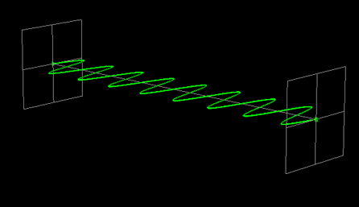
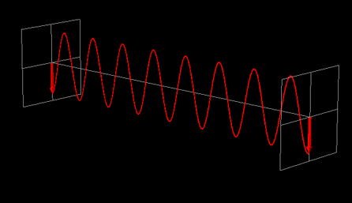
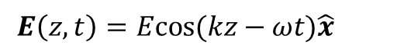
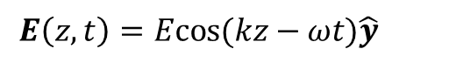
Unit 5
EM waves (light) are a vector field, not a scalar.
So far, we’ve mostly considered waves like:
$$E\left(z,t\right)=Ecos(kz−ωt)\hat{x}$$
$$E\left(z,t\right)=Ecos(kz−ωt)\hat{y}$$
To represent polarization more generally, need a case where fields are superpositions:
$$E\left(z,t\right)=\hat{x}E_{0x}\left(r,t\right)cos\left(kz−ωt+φ_{x}\right)+{\hat{y} E}_{0y}\left(r,t\right)cos\left(kz−ωt+φ_{y}\right)$$
The polarization of the wave is related to the direction of E,
but this direction can now be a time–dependent quantity.

Slide 5
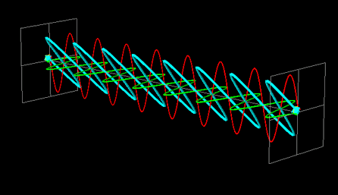
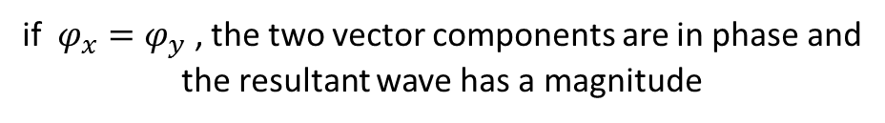
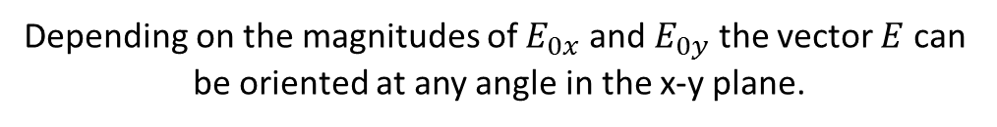
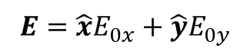
Unit 5
Arbitrary Linear Polarization
$$E\left(z,t\right)=\hat{x}E_{0x}\left(r,t\right)cos\left(kz−ωt+φ_{x}\right)+{\hat{y} E}_{0y}\left(r,t\right)cos\left(kz−ωt+φ_{y}\right)$$
if $φ_{x}=φ_{y}$ , the two vector components are in phase and
the resultant wave has a magnitude
$$E=\hat{x}E_{0x}+{\hat{y}E}_{0y}$$
Depending on the magnitudes of $E_{0x}$ and $E_{0y}$ the vector $E$ can
be oriented at any angle in the x-y plane.

Slide 6
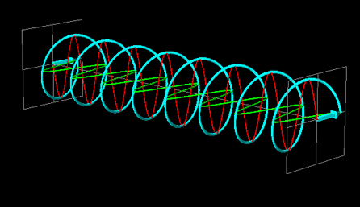
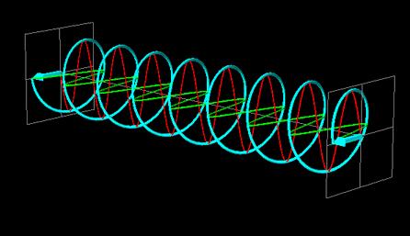
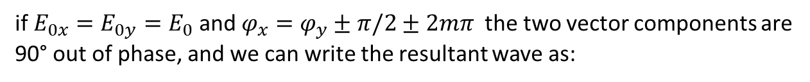
Unit 2
Circular Polarization
$$E\left(z,t\right)=\hat{x}E_{0x}\left(r,t\right)cos\left(kz−ωt+φ_{x}\right)+{\hat{y} E}_{0y}\left(r,t\right)cos\left(kz−ωt+φ_{y}\right)$$
if $E_{0x}=E_{0y}=E_{0}$and $φ_{x}=φ_{y}±π/2±2mπ$ the two vector components are
90° out of phase, and we can write the resultant wave as:
$$E\left(z,t\right)=E_{0} \left( \hat{x}cos\left(kz−ωt\right)±\hat{y} sin\left(kz−ωt\right) \right)$$
The electric field vector has a constant magnitude, but is rotating!
Left-circular
Right-circular
Counter- clockwise
Clockwise

Slide 7
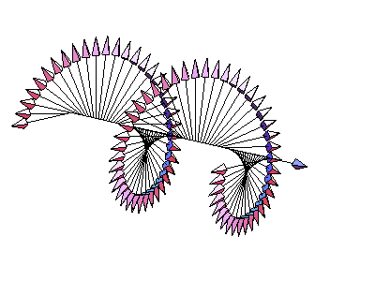
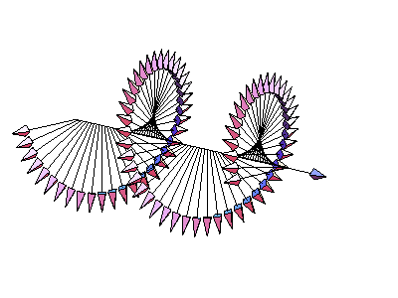
Unit 5
Angular Momentum of Photons
We saw that photons carry linear momentum, but they also have angular momentum!
The rotating electric field is associated with a non-zero spin angular momentum (±ћ) of the photon.
In particle physics, a photon is: relativistic, massless, spin-1 particle…
If there’s no such thing as a spin-0 photon, how do we get linearly polarized light?
LC: +ћ
RC: -ћ
Linearly polarized light is a coherent superposition of equal parts left and right!

Slide 8
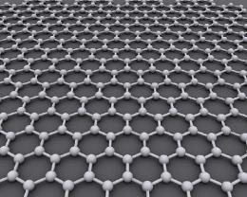
Unit 5
Angular Momentum of Photons
How can we observe this angular momentum affecting matter?
shine circularly polarized light on a very small object
Video: Optical torque on a calcite crystal
Amazing stuff: Spinning up the world’s fastest rotor with circularly polarized light!
Flake of graphene levitated in a trap in vacuum.
(has an extremely large Young’s modulus)
Start it spinning with a circularly polarized laser
Spins up to 60 million RPM (!) before breaking apart
Bruce Kane. "Levitated spinning graphene flakes in an electric quadrupole ion trap." Phys. Rev. B 82, 115441 (2010). DOI:10.1103/PhysRevB.82.115441 . "Levitated Spinning Graphene." arXiv:1006.3774v1

Slide 9
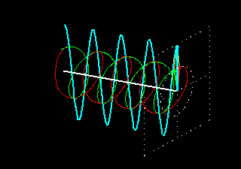
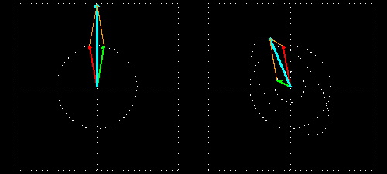
Unit 5
Polarization Combinations
RH Circular + LH Circular Superposition
= Linear Polarization!
E_{LHC} > E_{RHC}
→ Elliptic Polarization?

Slide 10
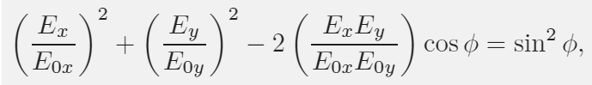
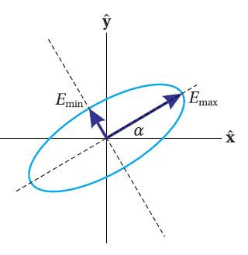
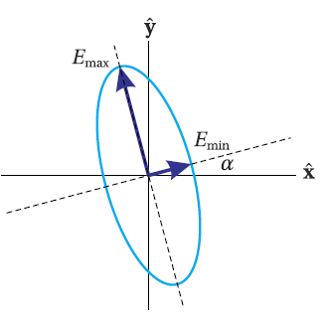
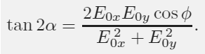
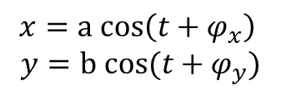
Unit 5
Elliptical Polarization
The x and y components of the electric field have the same
form as the parametric representation of an ellipse!
$$x=a cos\left(t+φ_{x}\right)$$
$$y=b cos(t+φ_{y})$$
Combining equations and doing a little algebra to eliminate time dependence we get:
Caution!
This is the equation for an ellipse rotated
by an angle α with respect to the x-axis

Slide 11
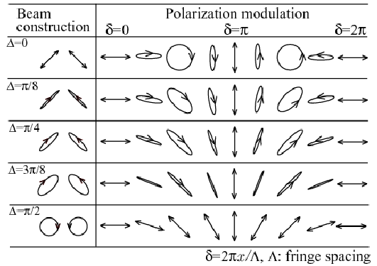
Unit 5
Optical Polarization States

Slide 12

Unit 5
Random & Partial Polarization
Most natural light does not have
a well-defined polarization
The electric field has some instantaneous direction, but it changes extremely rapidly in an essentially random way.
In the fully general case, light is not unpolarized, but either randomly or partially polarized.
For example:
sunlight reflecting off the surface of a lake
Description of fully polarized light:
Jones Matrices
Description of partially polarized light:
Mueller Matrices

Slide 13
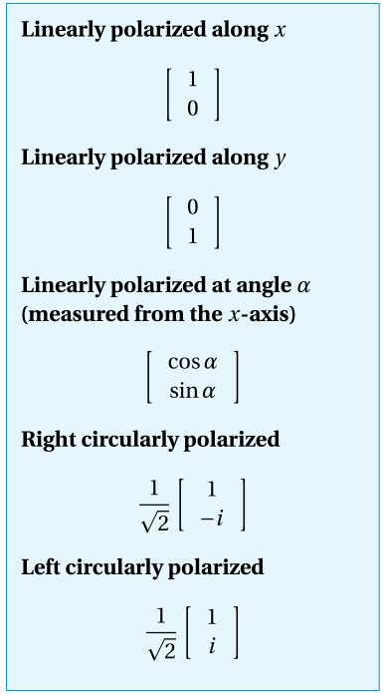
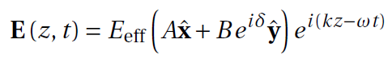
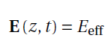
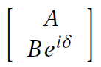
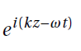
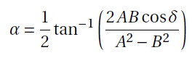
Unit 5
Jones Matrix Representation
In many problems involving just polarization, we drop the oscillatory part.
It’s a normalized unit vector.

Slide 14
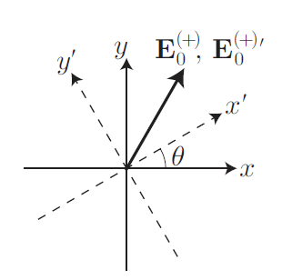
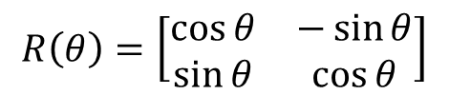
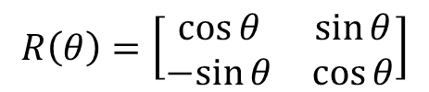
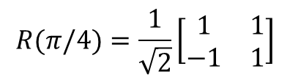
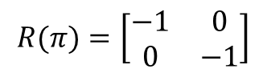
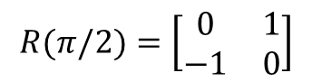
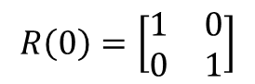
Unit 5
Rotation Matrix Representation
To represent an arbitrary rotation θ in the x-y plane
we use the rotation matrix R:
In a passive transformation, the coordinate system is moved.
In an active transformation, we move the object (vector) instead.
$$R\left(θ\right)=\left[\begin{matrix}\cos{θ} & \sin{θ} \\ −sin{θ} & \cos{θ}\end{matrix}\right]$$
$$R\left(θ\right)=\left[\begin{matrix}\cos{θ} & −\sin{θ} \\ \sin{θ} & \cos{θ}\end{matrix}\right]$$
Special cases (passive rotation):
$$R\left(0\right)=\left[\begin{matrix}1 & 0 \\ 0 & 1\end{matrix}\right]$$
$$R(π/4)=\frac{1}{\sqrt{2}}\left[\begin{matrix}1 & 1 \\ −1 & 1\end{matrix}\right]$$
$$R(π)=\left[\begin{matrix}−1 & 0 \\ 0 & −1\end{matrix}\right]$$
$$R(π/2)=\left[\begin{matrix}0 & 1 \\ −1 & 0\end{matrix}\right]$$

Slide 15
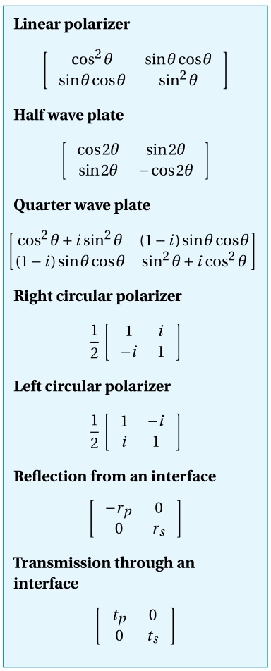
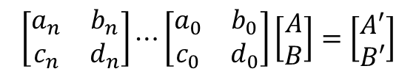
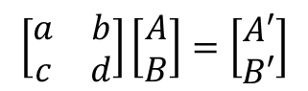
Unit 5
Jones Matrix Transformations
The real utility of the Jones formalism is that we can represent the effect of any linear optical element on the polarization of an input beam as follows:
$$\left[\begin{matrix}a & b \\ c & d\end{matrix}\right]\left[\begin{matrix}A \\ B\end{matrix}\right]=\left[\begin{matrix}A′ \\ B′\end{matrix}\right]$$
If light goes through a series of elements, we can chain the matrices:
$$\left[\begin{matrix}a_{n} & b_{n} \\ c_{n} & d_{n}\end{matrix}\right]⋯\left[\begin{matrix}a_{0} & b_{0} \\ c_{0} & d_{0}\end{matrix}\right]\left[\begin{matrix}A \\ B\end{matrix}\right]=\left[\begin{matrix}A′ \\ B′\end{matrix}\right]$$
The matrices are generally non-commutative and order is important!

Slide 16
Unit 5
Polarization Optics
Anything that exerts an affect on polarization states
Reflections from surfaces (Fresnel)
Scattering from very small particles
Non-isotropic physical materials
birefringent crystals like calcite
chiral materials like corn syrup
almost any clear material when stressed!

Slide 17
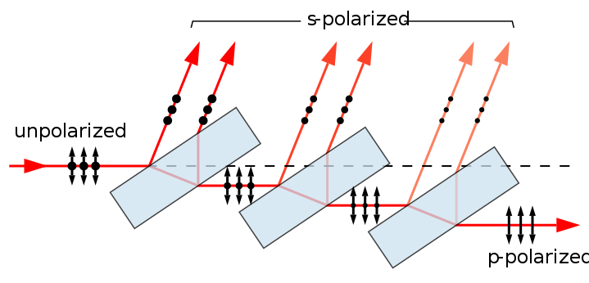
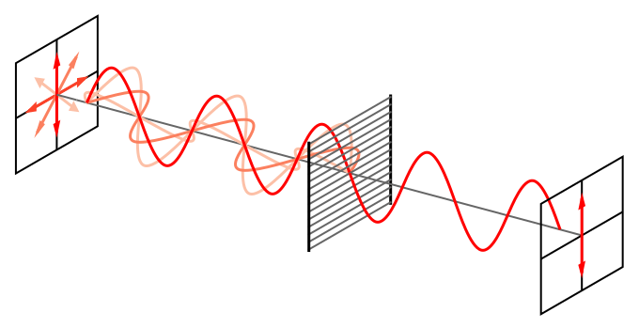
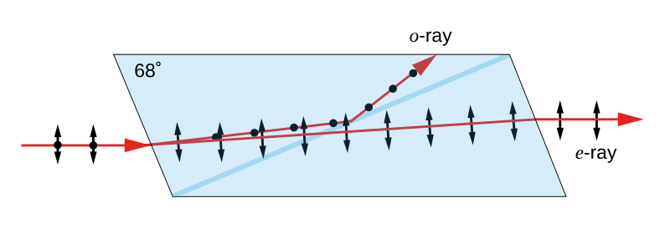
Unit 5
Polarization Optics
pile-of-plates
(Fresnel reflection)
wire grid array
(reflection)
birefringent crystal
(Snell’s Law!)

Slide 18
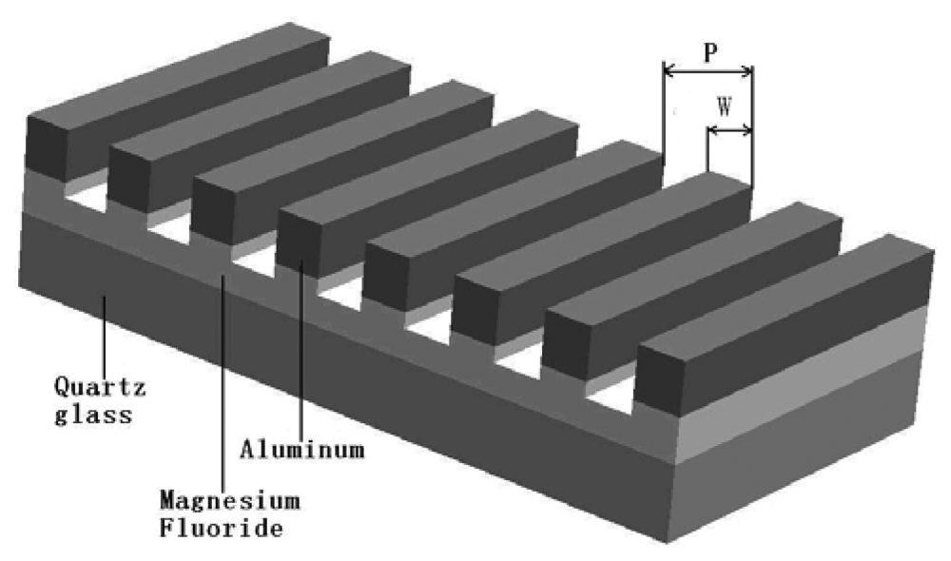
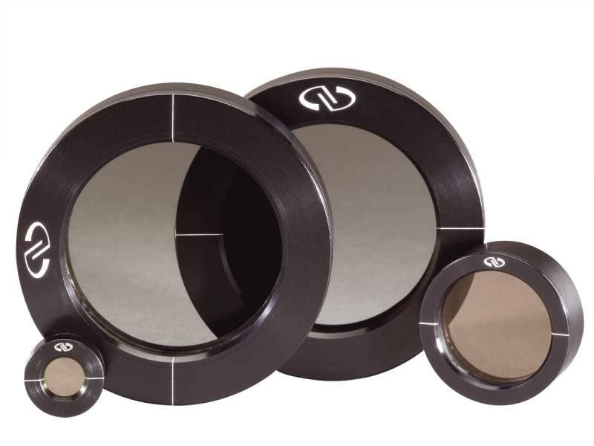
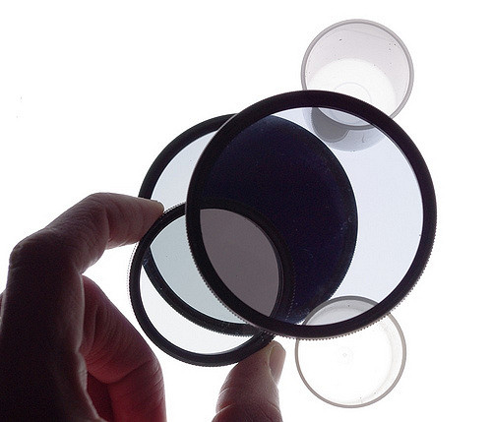
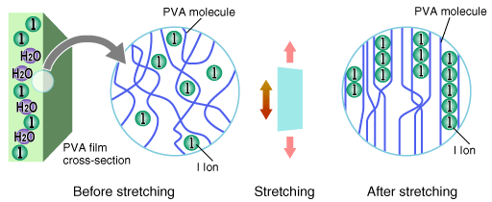
Unit 5
Polarization Filters
!

Slide 19
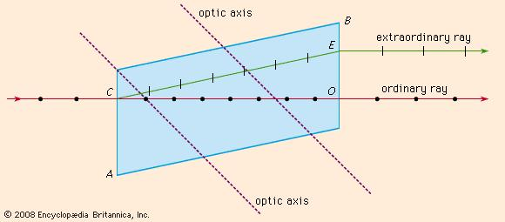
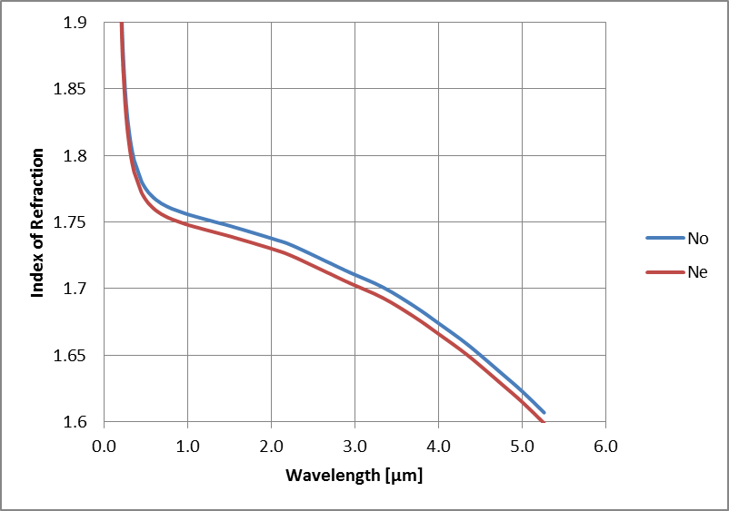
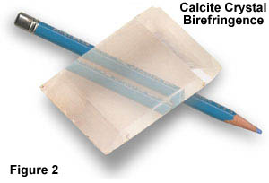
Unit 5
Birefringence (bi-refractance)
sapphire

Slide 20



Unit 5
Isotropic Media

Slide 21








Unit 5
Anisotropic Media

Slide 22



Unit 5
Applications: LCD

Slide 23



Unit 5
Applications: LCD

Slide 24

Unit 5
Applications: Ultra-Privacy Monitor
https://www.youtube.com/watch?v=zL_HAmWQTgA
Why replace the polarizer with another polarizer, though?...

Slide 25



Unit 5
Applications: IMAX 3D
Projector(s)

Slide 26




Unit 5
Applications: 3D Television
OR

